Slide 1

UNIVERSITY INSTITUTE OF ENGINEERING
COMPUTER SCIENCE ENGINEERING
Machine Learning
23CSH-651
By
Dr. Meena Pundir
INTRODUCTION
DISCOVER . LEARN . EMPOWER

Slide 2
Bayesian Networks

Slide 3
Bayesian networks
A simple, graphical notation for conditional independence assertions and hence for compact specification of full joint distributions
Syntax:
a set of nodes, one per variable
a directed, acyclic graph (link ≈ "directly influences")
a conditional distribution for each node given its parents:
P (X_{i} | Parents (X_{i}))
In the simplest case, conditional distribution represented as a conditional probability table (CPT) giving the distribution over X_{i} for each combination of parent values
A node is independent of its nondescendents given its parents.

Slide 4
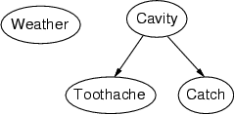
Example
Topology of network encodes conditional independence assertions:
Weather is independent of the other variables
Toothache and Catch are conditionally independent given Cavity

Slide 5
Example
I'm at work, neighbor John calls to say my alarm is ringing, but neighbor Mary doesn't call. Sometimes it's set off by minor earthquakes. Is there a burglar?
Variables: Burglary, Earthquake, Alarm, JohnCalls, MaryCalls
Network topology reflects "causal" knowledge:
A burglar can set the alarm off
An earthquake can set the alarm off
The alarm can cause Mary to call
The alarm can cause John to call

Slide 6
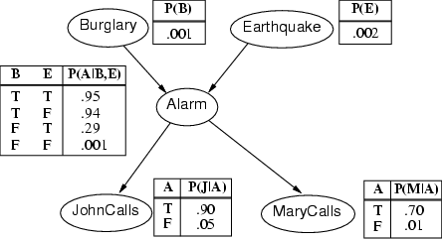
Example contd.

Slide 7
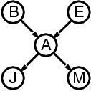
Compactness
A CPT for Boolean X_{i} with k Boolean parents has 2^{k} rows for the combinations of parent values
Each row requires one number p for X_{i} = true (the number for X_{i} = false is just 1-p)
If each variable has no more than k parents, the complete network requires O(n · 2^{k}) numbers
I.e., grows linearly with n, vs. O(2^{n}) for the full joint distribution
For burglary net, 1 + 1 + 4 + 2 + 2 = 10 numbers (vs. 2⁵-1 = 31)

Slide 8
Semantics
The full joint distribution is defined as the product of the local conditional distributions:
P (X₁, … ,X_{n}) = Π_{i = 1} P (X_{i} | Parents(X_{i}))
e.g., P(j ∧ m ∧ a ∧ ¬b ∧ ¬e)
= P (j | a) P (m | a) P (a | ¬b, ¬e) P (¬b) P (¬e)
n
A node is independent of its non-descendents given its parents.

Slide 9
Constructing Bayesian networks
1. Choose an ordering of variables X₁, … ,X_{n}
2. For i = 1 to n
add X_{i} to the network
select parents from X₁, … ,X_{i-1} such that
P (X_{i} | Parents(X_{i})) = P (X_{i} | X₁, ... X_{i-1})
This choice of parents guarantees:
P (X₁, … ,X_{n}) = π_{i =1} P (X_{i} | X₁, … , X_{i-1}) (chain rule)
= π_{i =1}P (X_{i} | Parents(X_{i})) (by construction)
n
n

Slide 10
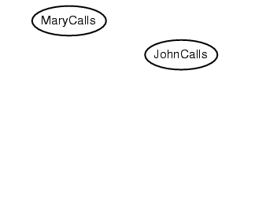
Example
Suppose we choose the ordering M, J, A, B, E
P(J | M) = P(J)?

Slide 11
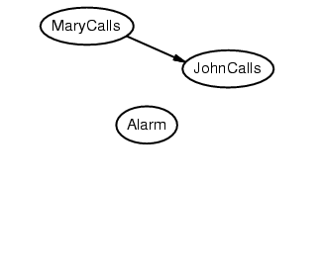
Example
Suppose we choose the ordering M, J, A, B, E
P(J | M) = P(J) No
P(A | J, M) = P(A | J)? P(A | J, M) = P(A)?

Slide 12
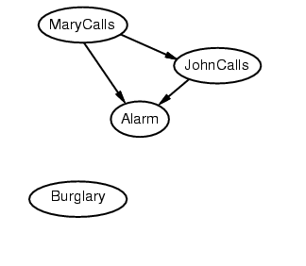
Example
Suppose we choose the ordering M, J, A, B, E
P(J | M) = P(J) No
P(A | J, M) = P(A | J)? P(A | J, M) = P(A)? No
P(B | A, J, M) = P(B | A)?
P(B | A, J, M) = P(B)?

Slide 13
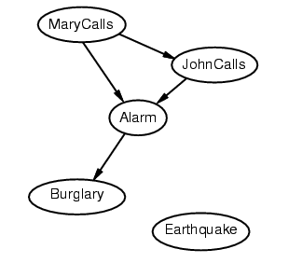
Example
Suppose we choose the ordering M, J, A, B, E
P(J | M) = P(J) No
P(A | J, M) = P(A | J)? P(A | J, M) = P(A)? No
P(B | A, J, M) = P(B | A)? Yes
P(B | A, J, M) = P(B)? No
P(E | B, A ,J, M) = P(E | A)?
P(E | B, A, J, M) = P(E | A, B)?

Slide 14
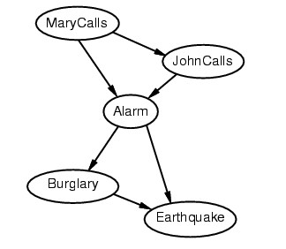
Example
Suppose we choose the ordering M, J, A, B, E
P(J | M) = P(J) No
P(A | J, M) = P(A | J)? P(A | J, M) = P(A)? No
P(B | A, J, M) = P(B | A)? Yes
P(B | A, J, M) = P(B)? No
P(E | B, A ,J, M) = P(E | A)? No
P(E | B, A, J, M) = P(E | A, B)? Yes

Slide 15
Example contd.
Deciding conditional independence is hard in noncausal directions
(Causal models and conditional independence seem hardwired for humans!)
Network is less compact: 1 + 2 + 4 + 2 + 4 = 13 numbers needed

Slide 16
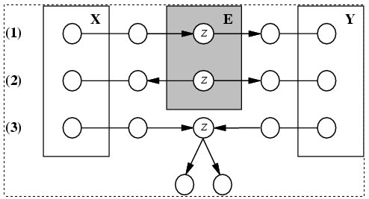
Conditional independence and D-separation
Two sets of nodes, X and Y, are conditionally independent given an evidence set of nodes, E if every undirected path from a node in X to a node in Y is d-seperated by E.
A set of nodes, E d-separates to sets of nodes, X and Y, if every undirected path from a node in X to a node in Y is blocked by E
A path is blocked given E if there is a node Z on the path for which one of the following holds:

Slide 17
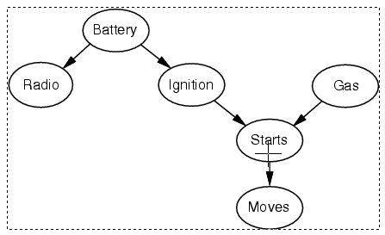
Conditional independence and D-separation - example

Slide 18
Some Applications of BN
Medical diagnosis
Troubleshooting of hardware/software systems
Fraud/uncollectible debt detection
Data mining
Analysis of genetic sequences
Data interpretation, computer vision, image understanding

